Slide 1
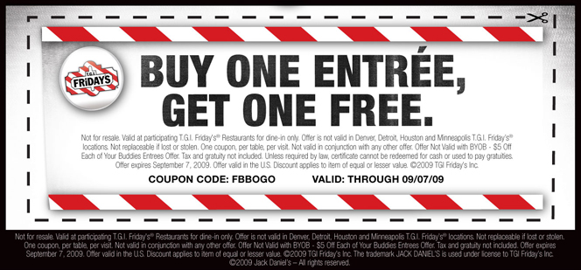
Satwik Akunuri Dominic Satish Peter Jeyales Satya Bhagat Pichikala Vatsal Ajmera
TGI FRIDAYS
Group 12

Slide 2
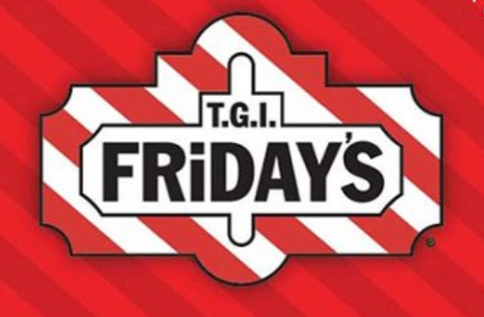
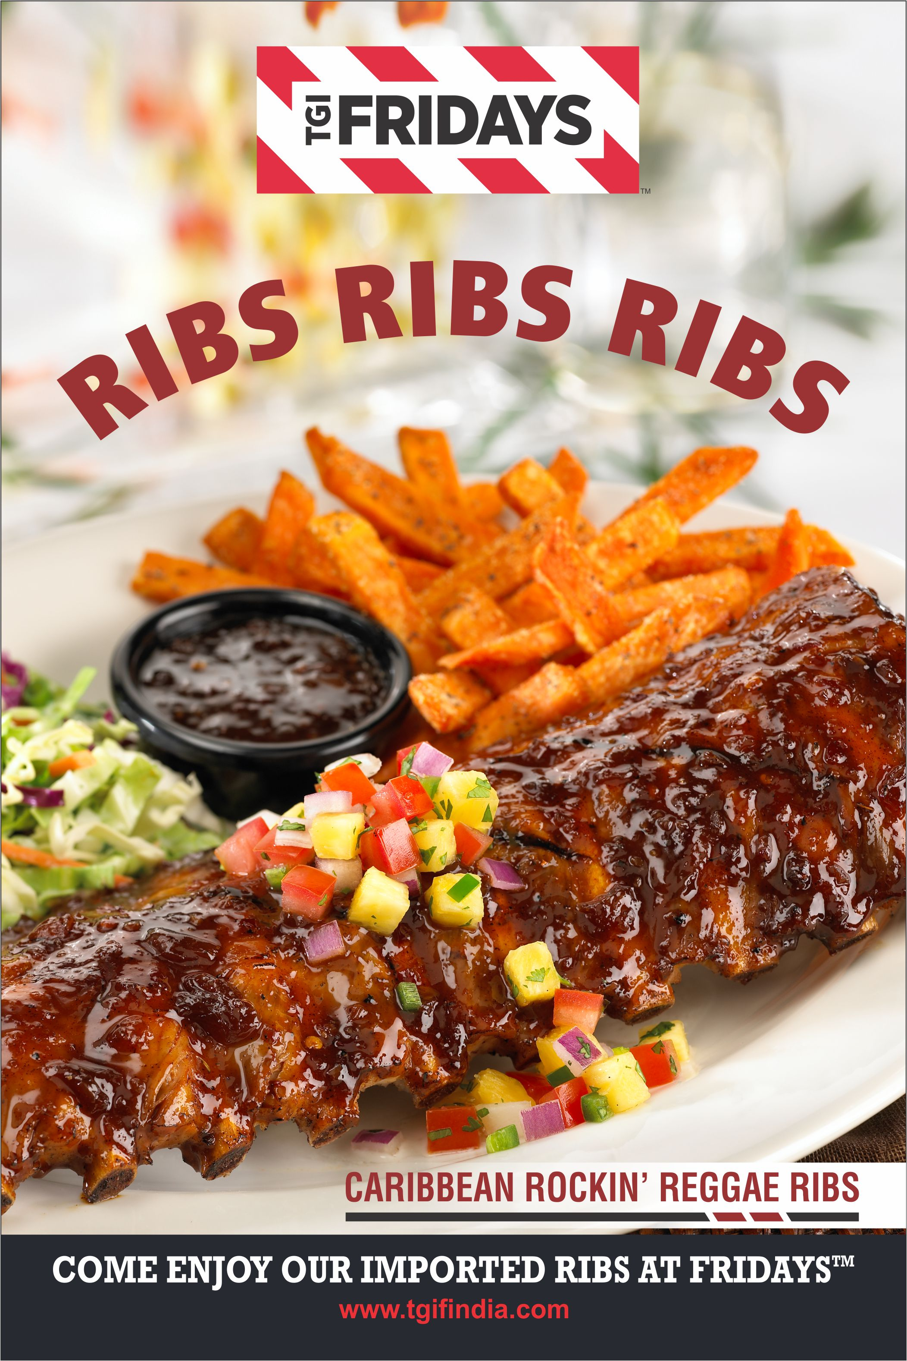
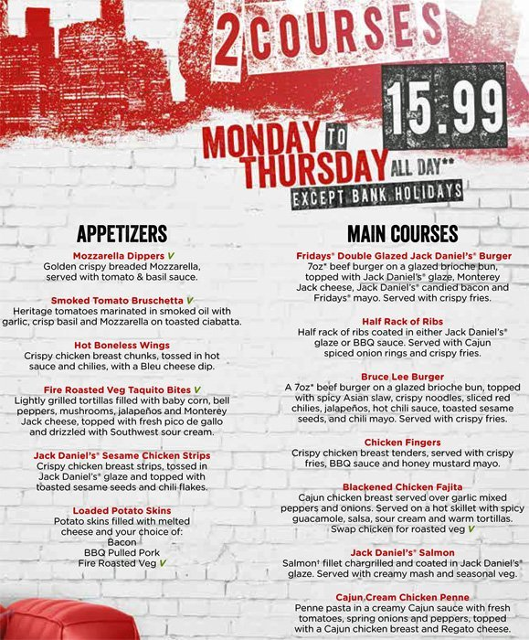
AGENDA
Data Overview
Executive Summary
Financial Implications
Cluster Overview
Business Objective
Marketing Strategy
Test Plan

Slide 3

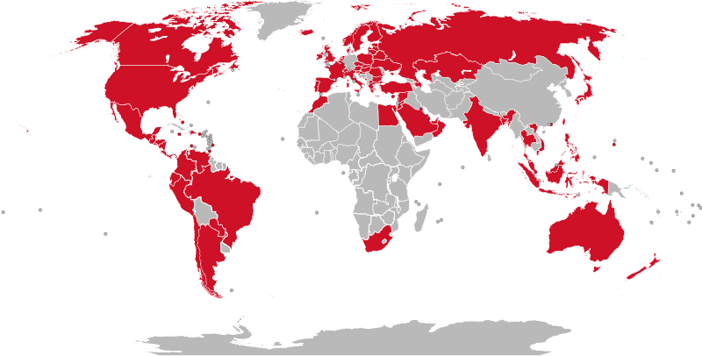
Executive Summary
T.G.I. Fridays is an American restaurant chain focusing on casual dining. Established in 1965.
It has 1000 restaurant in 61 countries.
T.G.I. Fridays wants to investigate the revenue across its store and determine marketing strategy to improve revenue.
Using Elasticity Modelling, Market Basket Analysis & Descriptive Analysis our strategy is to improve the total revenue by 5.3%

Slide 4
Business Objective &
Data Analysis Plan Overview
Response to price sensitivity
Discounts
Product Bundling
Most Revenue Contributing
Cluster Analysis
Survival Analysis
Data Segmentation
Understanding Trends, Price Sensitivity & revenue Contribution
Remove ineffective product discounts
Potential Areas for improvement
Least Revenue Contributing

Slide 5
Data Overview
Data Categories
Techniques Used
Email-Marcom Variables
Product Categories, alcohol, beverages purchased
Promotion Discount Variables
Location Variables
Quantity & Sales Variables
Descriptive Analysis
Cluster Analysis
Price Elasticity Modelling
Market Basket Analysis

Slide 6
Cluster Overview
Deal, Not that big a deal
Dine-In Dinnerites
Sober & Stable
The Frequenters
Lifetimers

Slide 7
Deal, Not that big a deal
Characteristics
Recommendations
Budget brunch goers
1464 Customers
Looking out for alcohol, beverage & drinks option with food.
Prefer discounts and BOGO deals
Possibly millennials combining lunch & brunch options
Reduce BOGO discount by 25% to 17%
Provide alcohol/beverage combo options to the brunch menu.
Frequency of return is decent and hence the price increase should be incremental.
Revenue Impact
5.41%
Beverages+ Brunch
Appetizers + Drinks
Brunch + Other Food

Slide 8
Dine-In Dinnerites
Characteristics
Recommendations
80% customers come for Dinner
Mostly families coming for dinners.
Alcohol & Appetizers are largely ordered together clubbed with food from Kid’s menu.
They prefer entrees, appetizers & options off the kid’s menu.
19.15% of the total customer
Reduce Discount to 21% to 12%
Reduce Brunch Promos
Provide Alcohol Appetizer combos & happy hour promotions.
Revenue Impact
5.42%
Alco + App Combos
Entrees + Drinks

Slide 9
Sober & Stable
Characteristics
Recommendations
27.6% of total customers
Largely visiting during lunch hours
Appetizers, Burgers, Sides & Steaks are more likely to go together.
Reduce Discount from 20% to 4%
Provide beverage combo options during brunch menu.
Revenue Impact
10.3%
Steak & Beverage
Heavy Entrees + Drinks

Slide 10
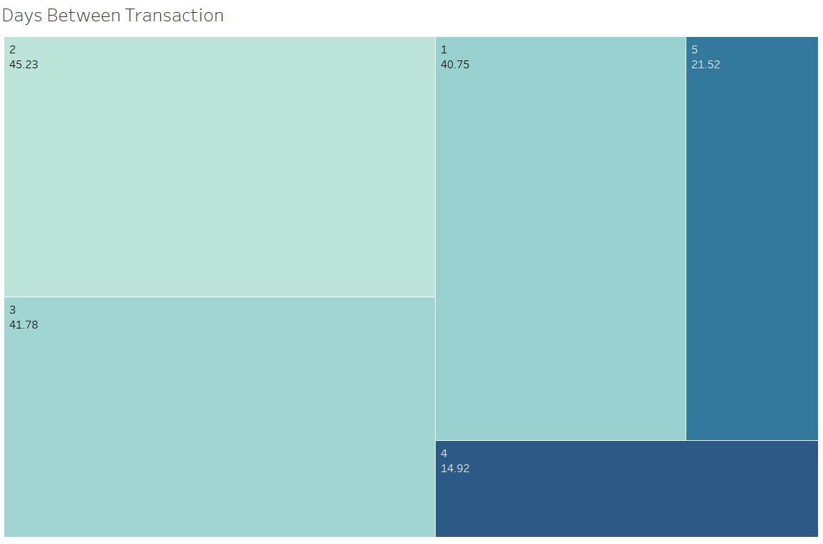
The Frequenters
Characteristics
Recommendations
3600 Customers
Most repeating customer. Visit often but unresponsive to marketing communication.
Come for drinks, appetizers, desserts & burgers.
Frequency is healthy with close to 2 visits a month.
Cut down the Discount
Reduce brunch promotions
Provide burger combos & happy hour promotions.
Revenue Impact
11.5%
Steak & Drinks
Burger + Combos

Slide 11
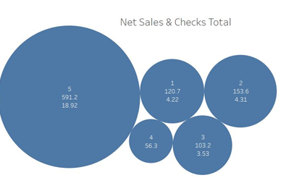
Lifetimers
Characteristics
Recommendations
Contributes to the most revenue, 42.13%
1324 Customers
Heighest average net sales of 591
Have a high lifetime return value
Interested in varied cuisines
Increase Discount to 18% to 25%
Increase the discount on food and Ribs
Revenue Impact
1.46%
Burgers
Soups

Slide 12
Test Plan
Test
Test Market
Test Impact
Monitor Monthly Financials based on recommendations
Test incremental price increase/decrease on samples
Monitor churn rate
Monitor changes due to bundling strategies
Take 2 samples from each cluster
Setup A control & experiment group
Recommendations are tested on the experimental group
Financial changes are compared and analysed

Slide 13
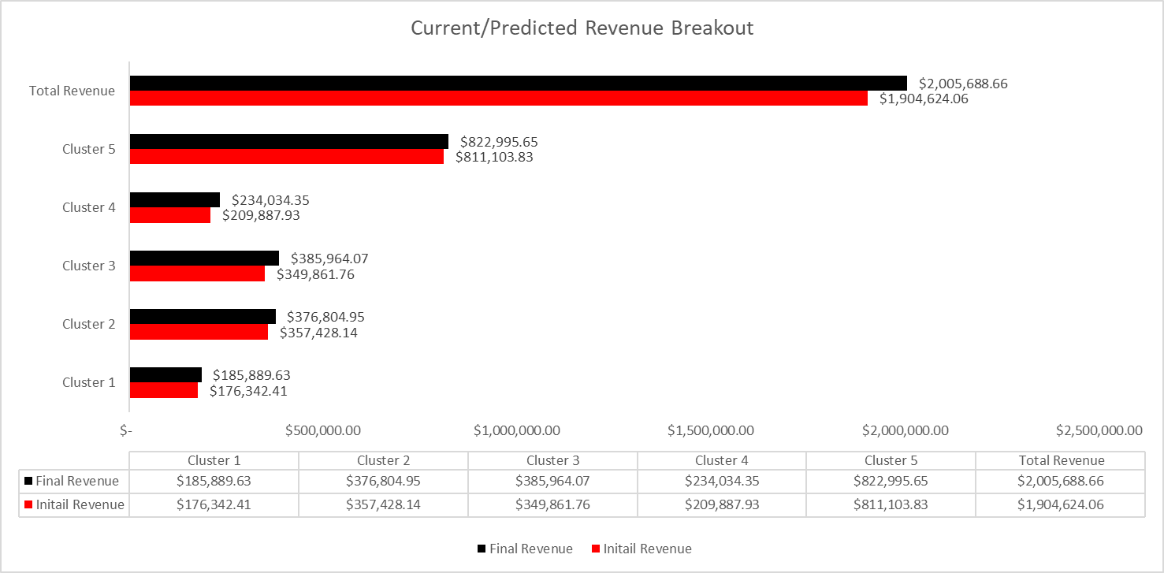
Financials

Slide 14

Questions

